Slide 1

Hypothesis Testing
~ Soham Satpute

Slide 2

Promising Alternative Hypothesis
~ The following hypotheses are close to the critical value (0.05)

Slide 3
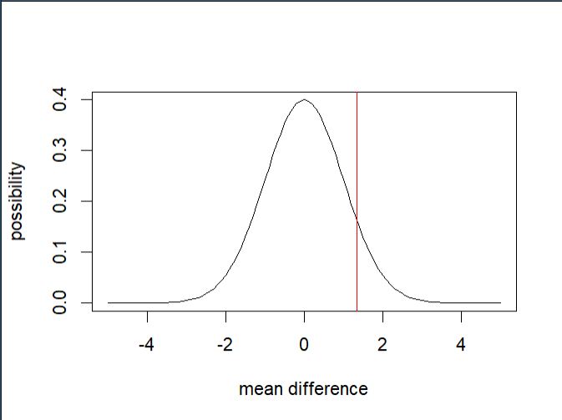
Do Rock Parties have higher attendance than Salsa parties on Thursday?
Mean Attendance
Rock: 47.52
Salsa: 53.12
P-value: 0.0898101

Slide 4
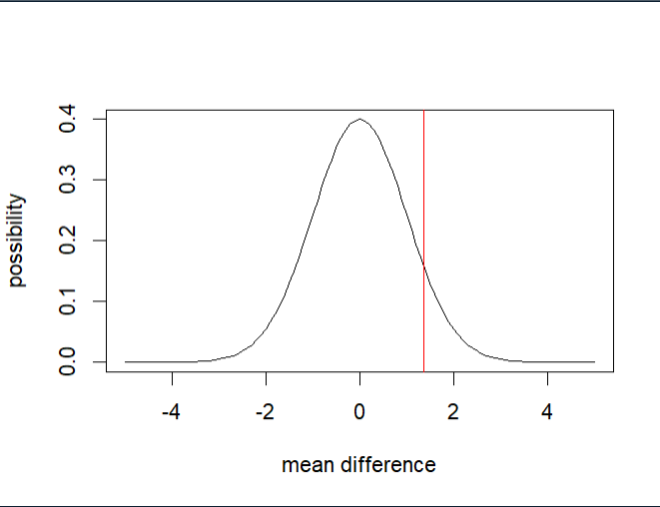
Do Jazz Parties have higher attendance than Techno Parties with Rohit DJ?
Mean Attendance
Techno: 52.98
Jazz: 59.58
P-value: 0.0858

Slide 5
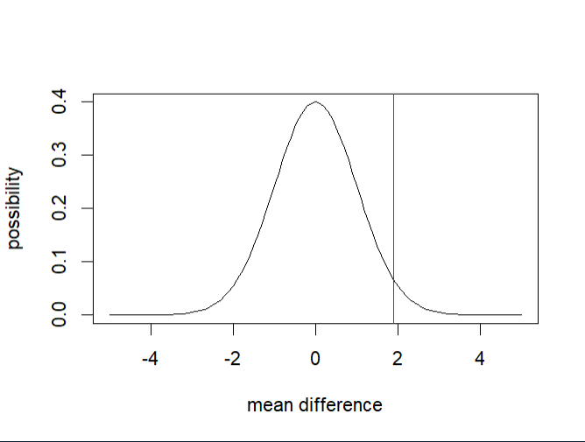
Do Techno Parties have higher attendance than Jazz Parties with Alex DJ?
Mean Attendance
Techno: 59.87
Jazz: 51.36
P-value: 0.0297

Slide 6

Alternative Hypothesis Based on P-Values
Very Small: 0.0022
Small: 0.0297
Large: 0.0858

Slide 7
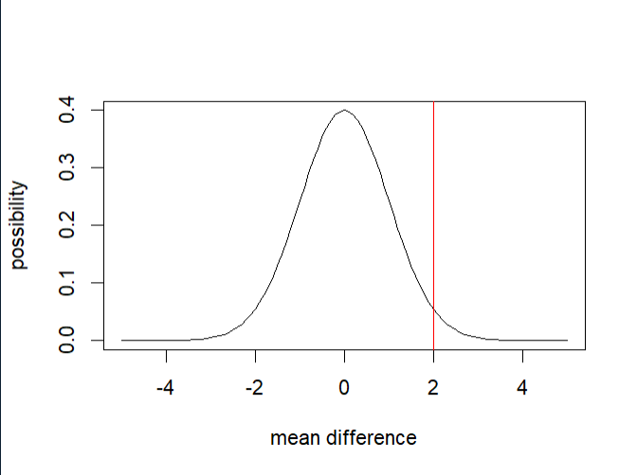
Null: Jazz Parties have the same attendance as Techno Parties with Alex DJ on Fridays Alternative: Jazz Parties have higher attendance than Techno Parties with Alex DJ on Fridays
Mean Attendance
Jazz: 47.92
Techno: 61.82
P-value: 0.0022
Since the P-value is less than the critical value (0.0022 < 0.05) we to reject the Null Hypothesis

Slide 8
Null: There is no difference between the Jazz Party and Techno Parties Attendance while Alex DJ is Playing Alternative: Jazz Parties have higher attendance than Techno Parties with Alex DJ
Since the P-value is less than the critical value (0.0297 < 0.05) we reject the Null Hypothesis
Mean Attendance
Techno: 59.87
Jazz: 51.36
P-value: 0.0297

Slide 9
Null: There is no difference between the Rock Party and Salsa Parties Attendance on Thursday Alternative: Rock Parties have higher attendance than Salsa parties on Thursday
Mean Attendance
Rock: 47.52
Salsa: 53.12
P-value: 0.0898101
Since the P-value is more than the critical value (0.0898 < 0.05) we fail to reject the Null Hypothesis

Slide 10

Thank You

